Slide 2

Mining and Classifying Vietnamese news
Introduction to Data Science - IT4142E
Group 04

Slide 3
Group 04 Members:
Nguyễn Đình Lộc 20194791
Trần Thế Thịnh 20194853
Đinh Hữu Đại 20194735
Bùi Quốc Thuận 20194854
Nguyễn Mạnh Dũng 20194745

Slide 4
Table of Content
Problem Introduction
Text Mining & Classifying
Data preparation
Data Cleaning & Preprocessing
Data integration
Group by category
Exploratory data analysis & Visualization
Evaluate some classifier in Machine Learning to classify the news
Conclusion

Slide 5
1. Problem Introduction

Slide 6
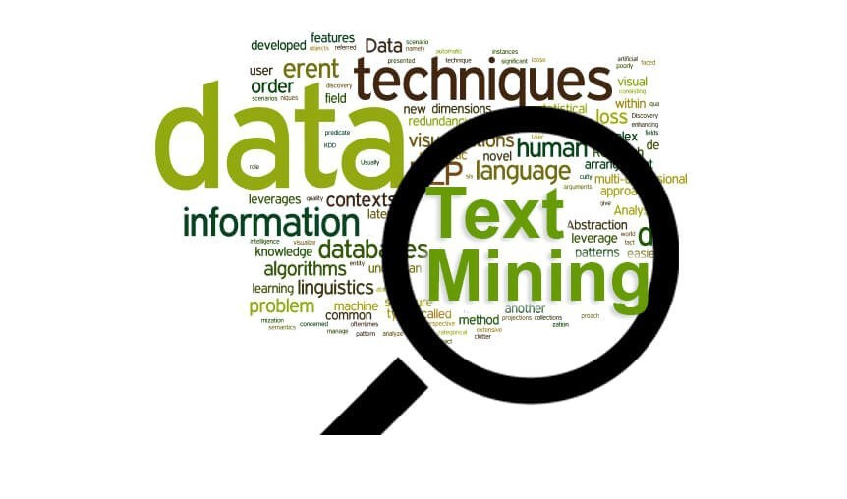
Problem Introduction
Text mining (Text analytics), the process of exploring and analyzing large amounts of unstructured text data aided by software that can identify concepts, patterns, topics, keywords and other attributes in the data.

Slide 7



Problem Introduction
In this project, we will attempt to apply some text processing, statistical analysis, and machine learning methods to text, particularly, mining and classifying Vietnamese News.

Slide 8
Process
Delivering the problem, we will follow 6 steps:
Data Preparation
Data Cleaning & Preprocessing
Data integration
Group by category
Exploratory data analysis & Visualization
Evaluate some classifier in Machine Learning to classify the news

Slide 9
2. Text Mining & Classifying

Slide 10
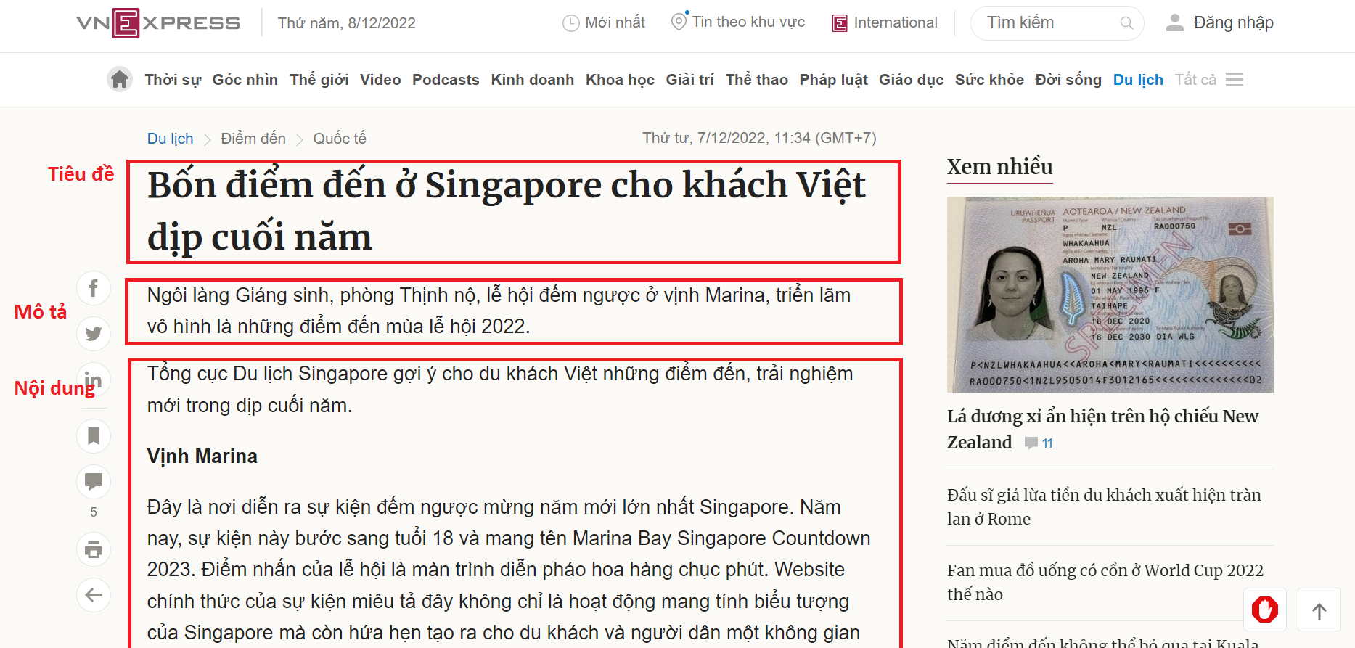
2.1. Data Preparation
The dataset are prepared from Vietnam's
news website: VNExpress
Use library BeautifulSoup4 in Python
for web scrapping
For each article, sequentially scrape three
text components: the title,
description, and content

Slide 11
2.1. Data Preparation
Scraping either one category at a time or all categories at once included 11 article types:
- Thời sự - Thể thao
- Du lịch - Pháp lụât
- Thế giới - Giáo dục
- Kinh doanh - Sức khỏe
- Khoa học - Đời sống
- Giải trí

Slide 12
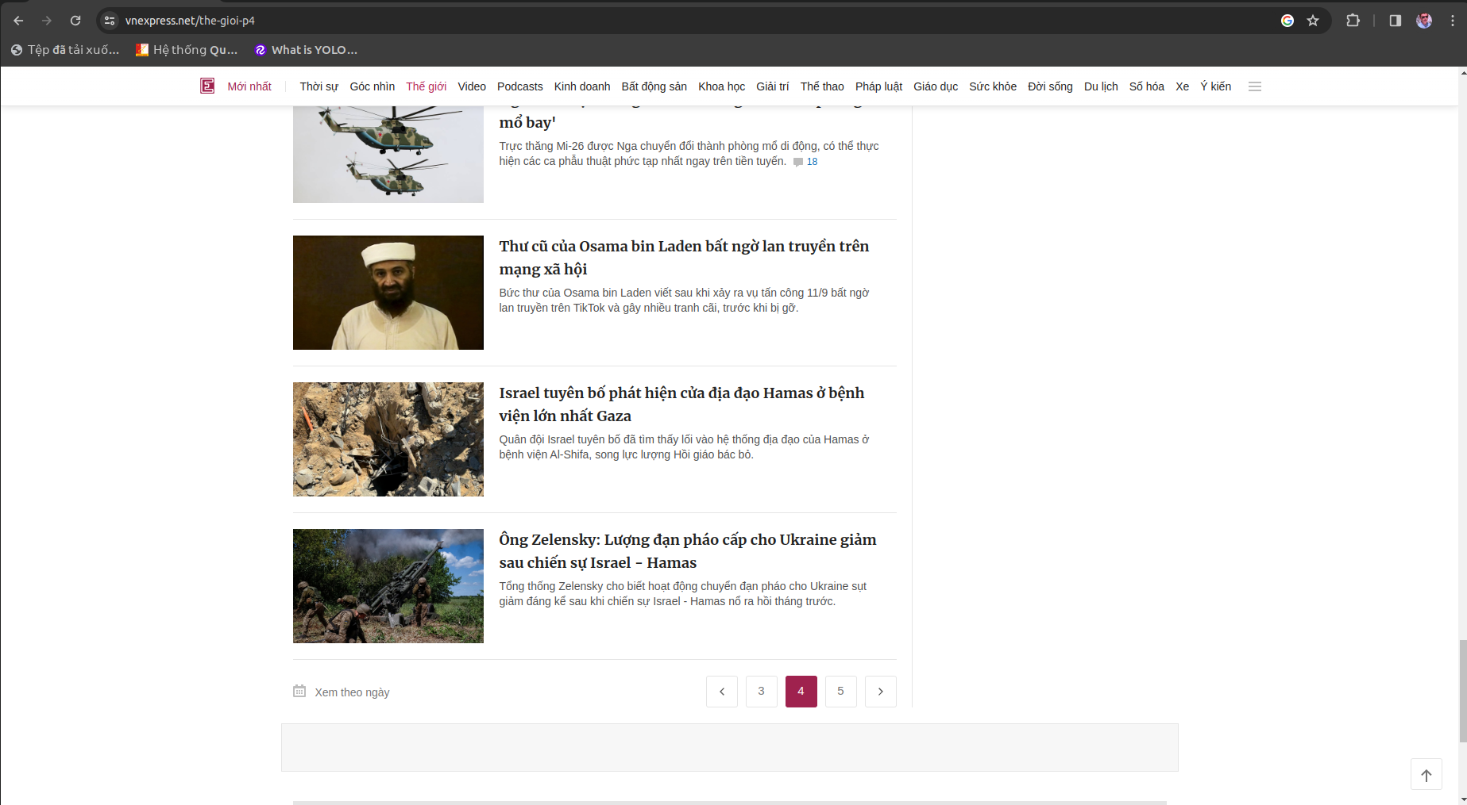
2.1. Data Preparation
Example: A multi-page article list

Slide 13
2.1. Data Preparation
Scraping one category at a time:
python types_crawler.py --type [ARTICLE_TYPE] --pages [TOTAL_PAGES] --output [OUTPUT_DPATH]
Scraping all categories at a time:
python types_crawler.py --all --pages [TOTAL_PAGES] --output [OUTPUT_DPATH]
Note: Not every scraping attempt is successful, If page lacks the predefined classes or tags, might not collect enough information

Slide 14
2.2. Data Cleaning & Preprocessing
After preparation, we conduct to process the data:
Remove the special character in text (dot, comma,…) by using gensim
Library, normalize the unknown authors
2. Using PyVi library to tokenize words in an articles' contents. Divide each article into 5 small parts: title data, description data, content data, author data and labels data
3. Save the processed data to pickle file for long-term purpose

Slide 15
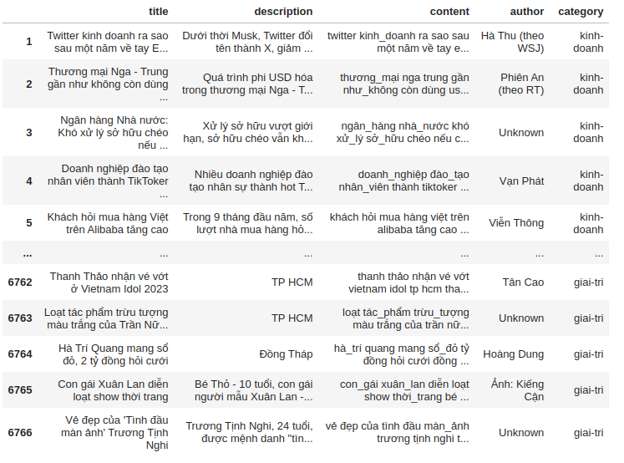
2.3. Data Integration
We load the processed data from pickle file in the previous step into 5 parts: title, description, content, author and labels
We integrate 5 above parts into one dataset. Each sample in this dataset has 5 corresponding fields:

Slide 16
2.3. Group by category
Following 11 categories:
- Đời sống - Pháp luật
- Du lịch - Sức khỏe
- Giải trí - Thế giới
- Giáo dục - Thể thao
- Khoa học - Thời sự
- Kinh doanh

Slide 17
2.4. Exploratory data analysis & Visualization
Number of articles: 6766
Number of categories: 11
Number of authors: 1288

Slide 18
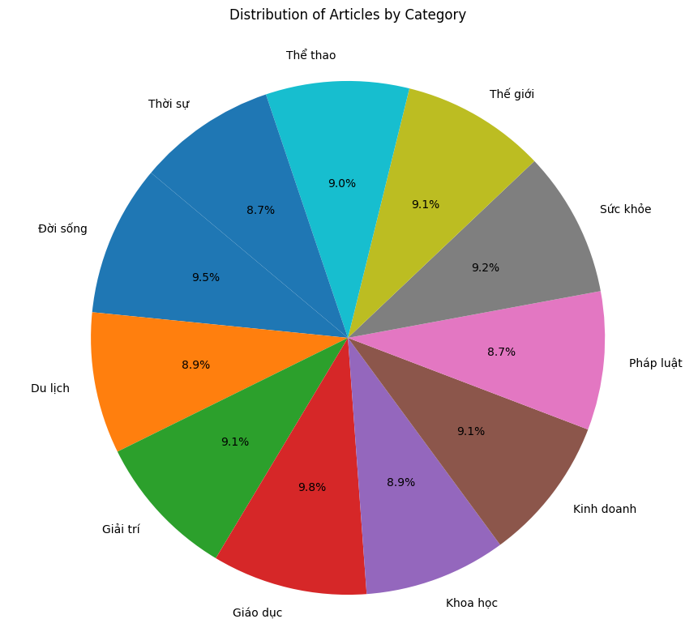
2.4. Exploratory data analysis & Visualization
Pie chart:
Number of articles in
different categories

Slide 19
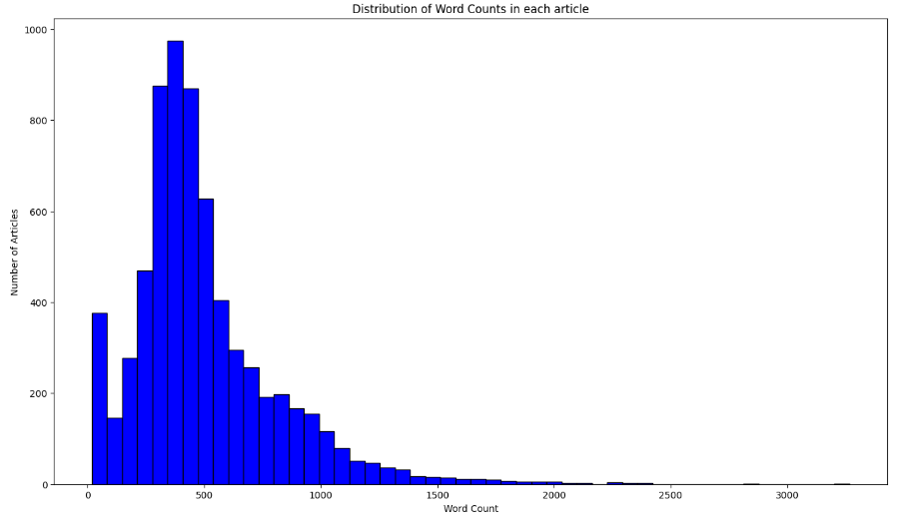
2.4. Exploratory data analysis & Visualization
Histogram: Word counts per article

Slide 20
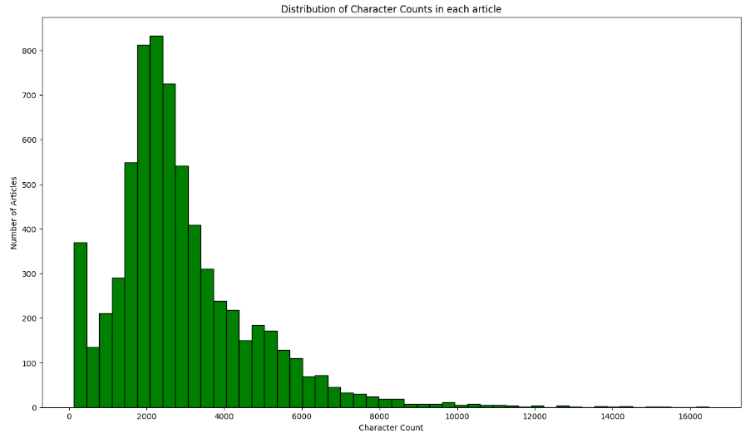
2.4. Exploratory data analysis & Visualization
Histogram: Character counts per article

Slide 21
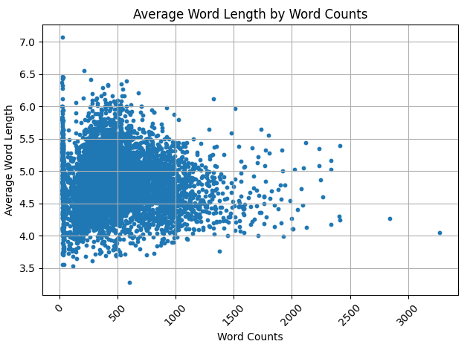
2.4. Exploratory data analysis & Visualization
Scatter: Average Word Length of each article by Word Counts

Slide 22
2.4. Exploratory data analysis & Visualization
Distribution of Stopwords in Articles:
- Stop words are the words in a stop list (or stoplist or negative dictionary) which are filtered out (i.e. 'anh', 'ba', 'biết',...) before or after processing of natural language data (text) because they are insignificant.
- We would not want these words to take up space in our database, or taking up valuable processing time. For this, we can remove them easily, by storing a list of words that you consider to stop words.

Slide 23
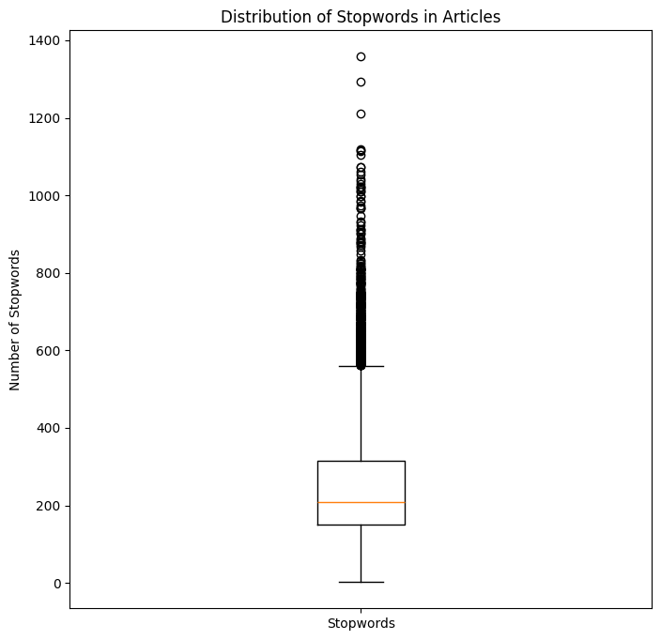
2.4. Exploratory data analysis & Visualization
After calculating, we count there are 300 stopwords in our data
Box plot: Distribution of Stopwords in Articles:

Slide 24
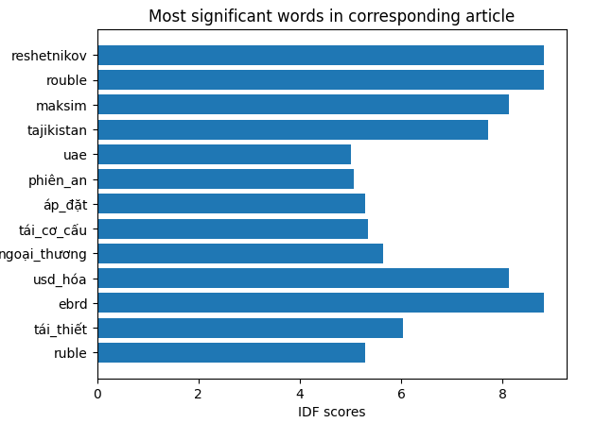
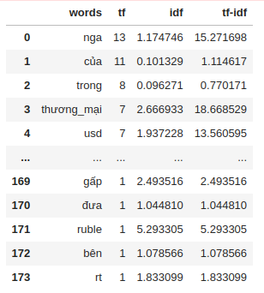
2.4. Exploratory data analysis & Visualization
Term frequency (TF), Inverse document frequency (IDF), and TF-IDF
We calculate and represent some significant words in corresponding article:

Slide 25
2.5. Experiment using ML techniques
Feature Engineering: Take the text data are processed into vector features has the numerical form.
We calculated: TF-IDF Vectors as features with 3 levels: Word level, N-gram level, Character level
We choose TF-IDF Vector in Word level to feed as input of classifiers

Slide 26
2.5. Experiment using ML techniques
Construct classifiers:
- Multinomial Naïve Bayes
- Bernoulli Naïve Bayes
- Logistic Regression
- Support Vector Machine
- Random Forest
- Gradient Boosting

Slide 27
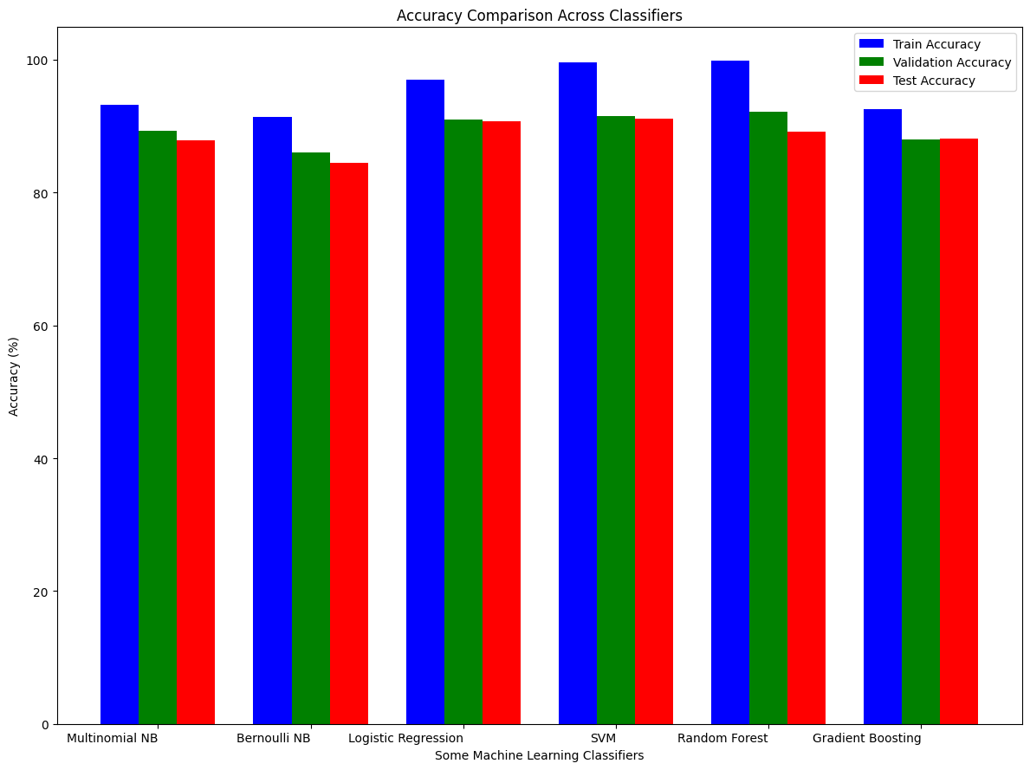
2.6. Experiment using ML techniques
Data: Train / Test = 7 / 3
Metric: Accuracy score

Slide 28
3. Conclusion

Slide 29
3. Conclusion
We focused on text mining and classifying Vietnamese news. It involves collecting data from VNExpress using BeautifulSoup, preprocessing with tools, integrating this data for exploratory analysis, and applying some machine learning classifiers to categorize news content effectively.

Slide 30
THANK YOU !

